Slide 1
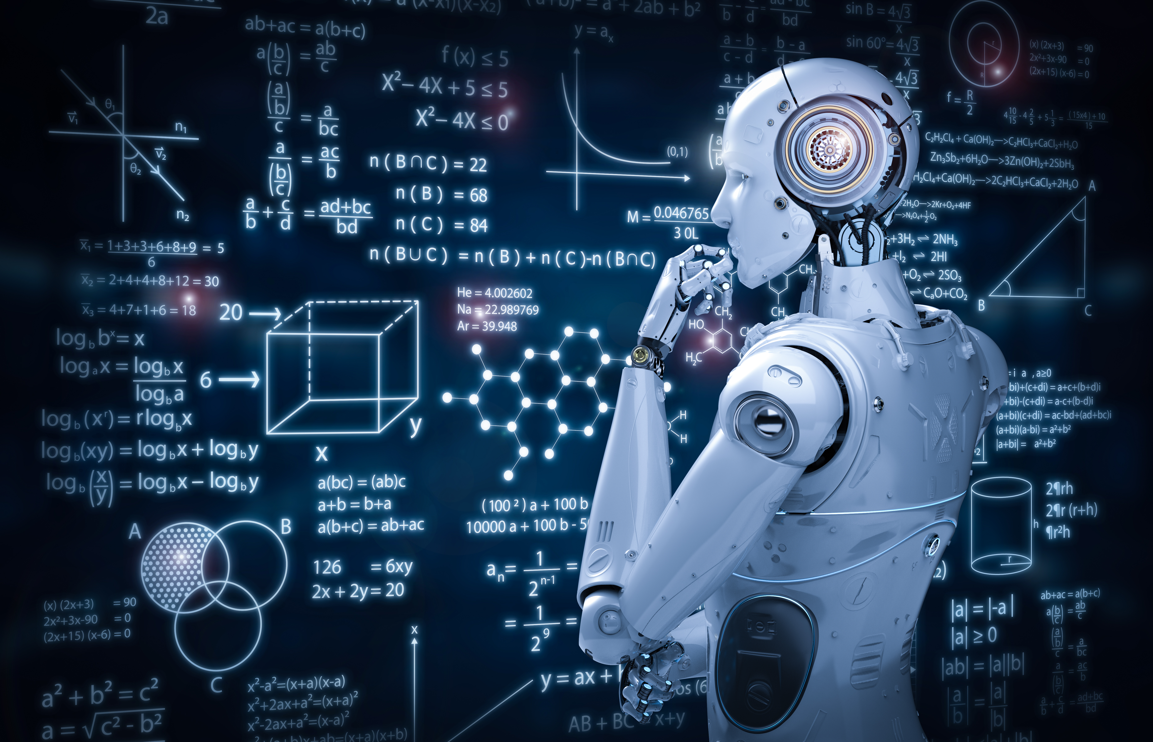








Faculty for Mathematics, Informatics, and Statistics
Department of Mathematics
Bavarian AI Chair “Mathematical Foundations of Artificial Intelligence”
Reliable and Sustainable AI: From Mathematical Foundations to Next Generation AI Computing
Gitta Kutyniok
Ludwig-Maximilians-Universität München
(also DLR – German Aerospace Center
& University of Tromsø, Norway)
ML in PL Conference 2025
Warsaw, October 15 - 18, 2025

Slide 2

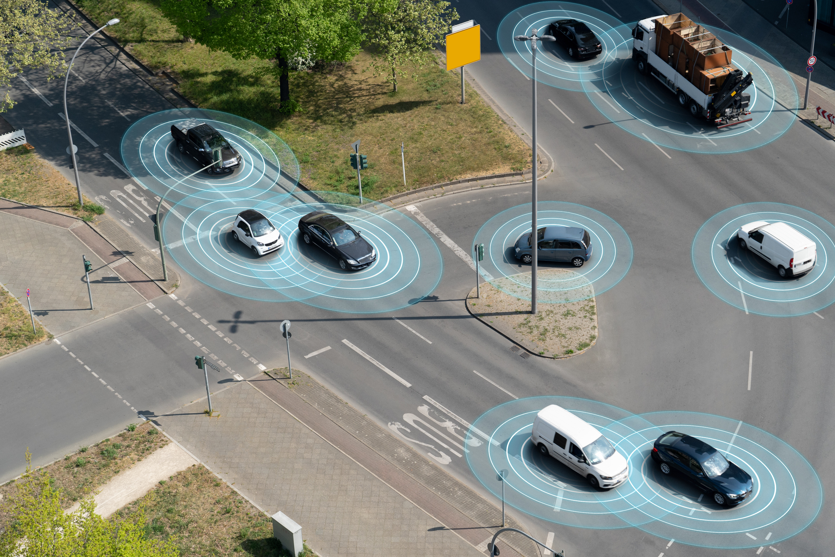

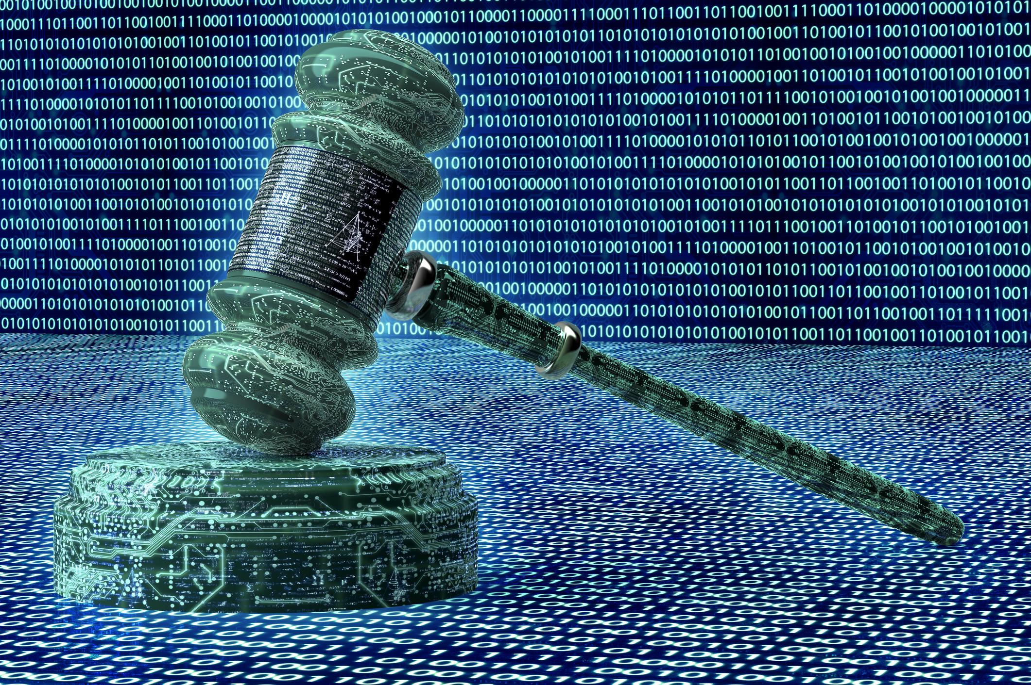
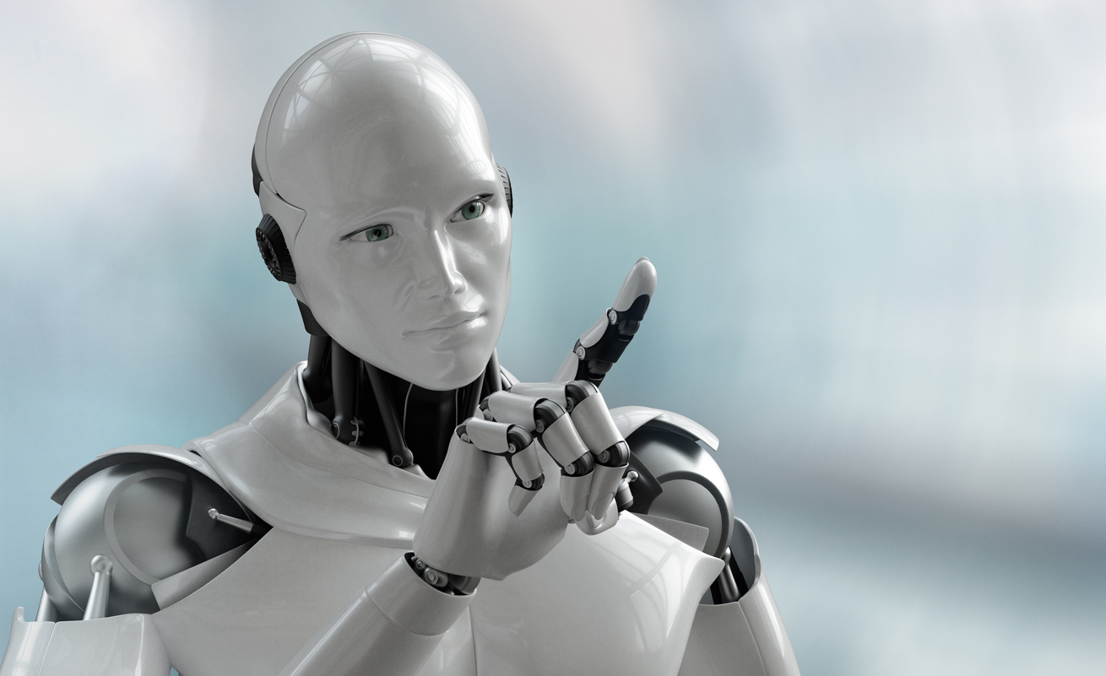

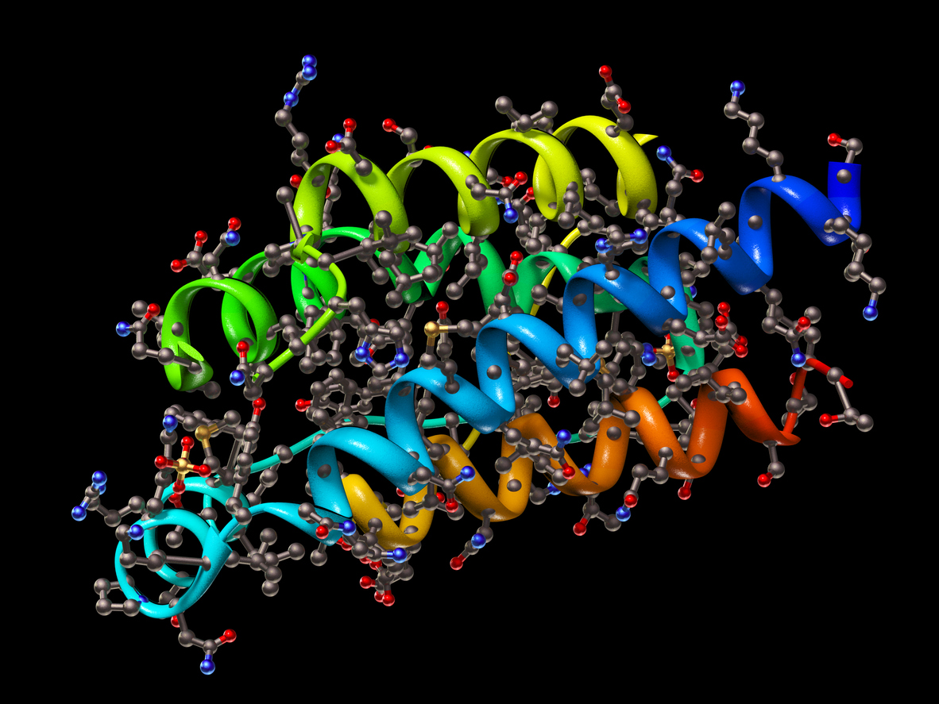


Fourth Industrial Revolution by Artificial Intelligence
Radical Change of our Society in its Full Breadth!

Slide 3
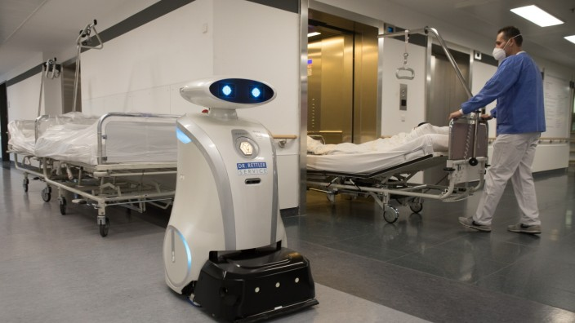

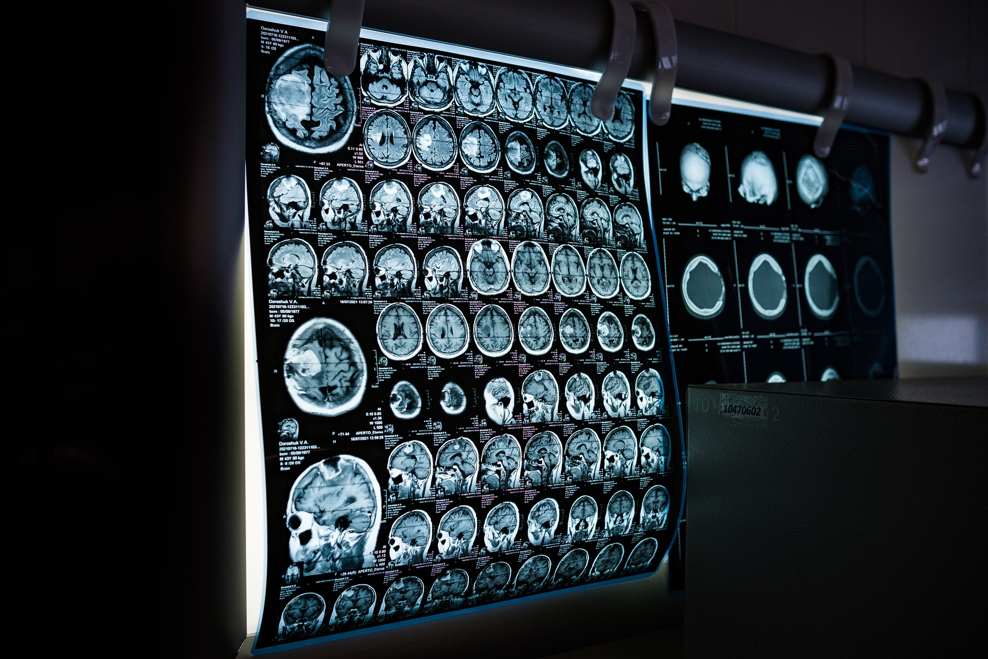

Challenges in Artificial Intelligence: Reliability
Problems with Safety
Example: Accidents involving robots
Current major problem
worldwide:
Lack of reliability of
AI technology!
Problems with Security
!
Example: Risks of hacking into AI systems
Problems with Privacy
Example: Privacy violations of health data
Deep understanding from a mathematical perspective!
Problems with Responsibility
Example: Black-box and biased decisions

Slide 4
Challenges in Artificial Intelligence: Sustainability / Energy Efficiency
Source: Twitter/X, Sept. 2024

Slide 5


Challenges in Artificial Intelligence: Sustainability / Energy Efficiency
Source: Decadal Plan of the Semiconductor Research Corporation for the Biden (US) Administration, 2021

Slide 6
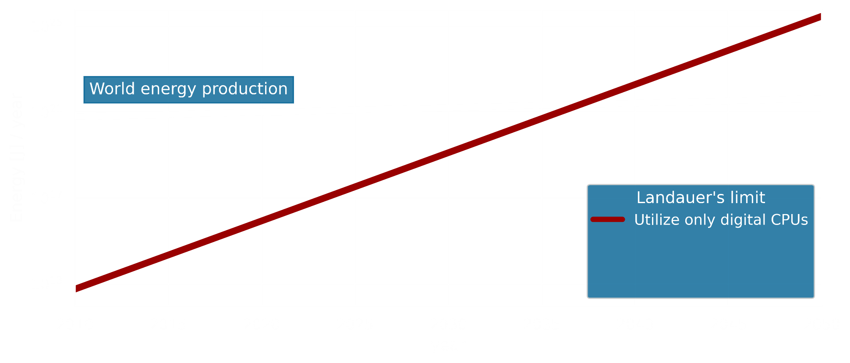
Challenges in Artificial Intelligence: Sustainability / Energy Efficiency
Source: Decadal Plan of the Semiconductor Research Corporation for the Biden (US) Administration, 2021

Slide 7
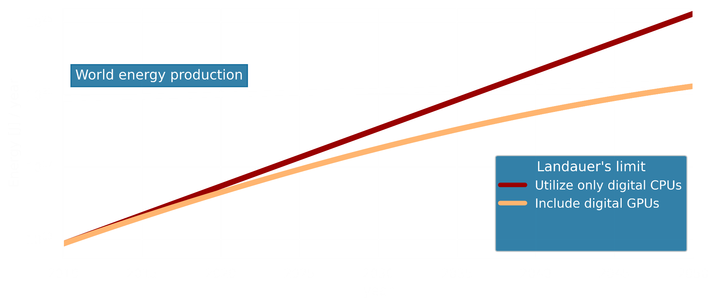
Challenges in Artificial Intelligence: Sustainability / Energy Efficiency
Source: Decadal Plan of the Semiconductor Research Corporation for the Biden (US) Administration, 2021

Slide 8
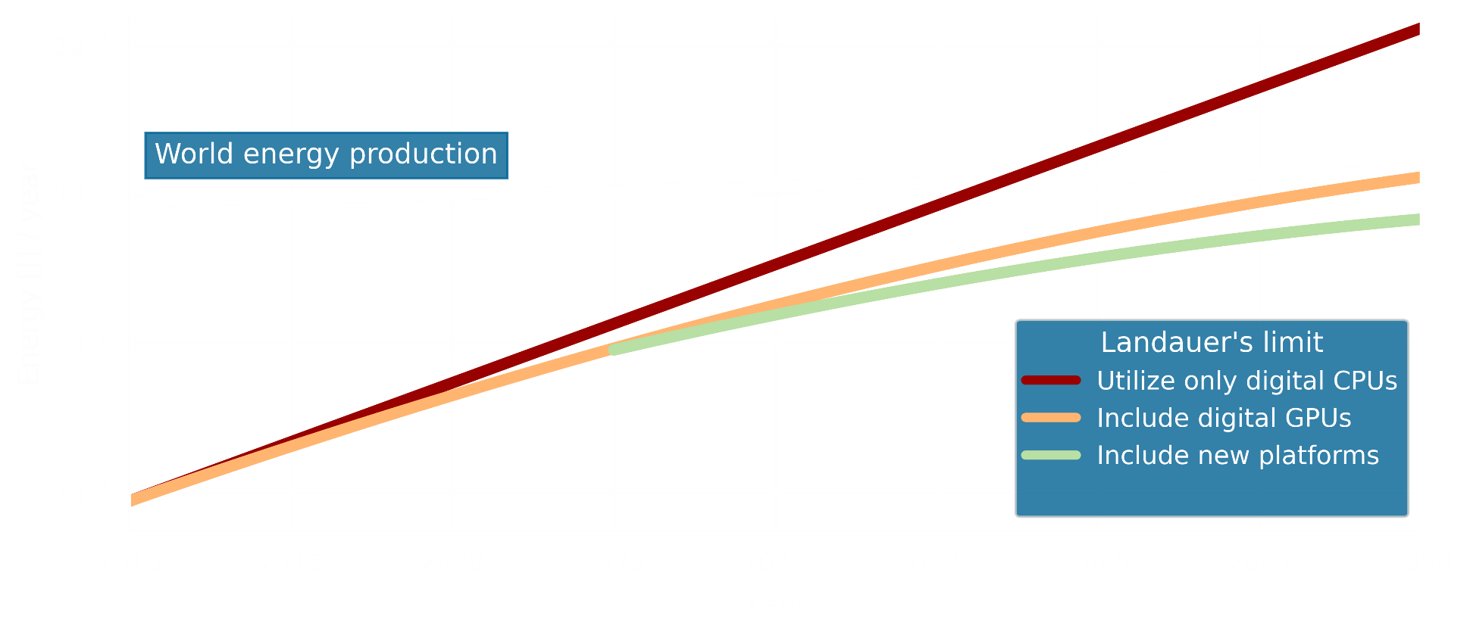
Challenges in Artificial Intelligence: Sustainability / Energy Efficiency
Source: Decadal Plan of the Semiconductor Research Corporation for the Biden (US) Administration, 2021

Slide 9
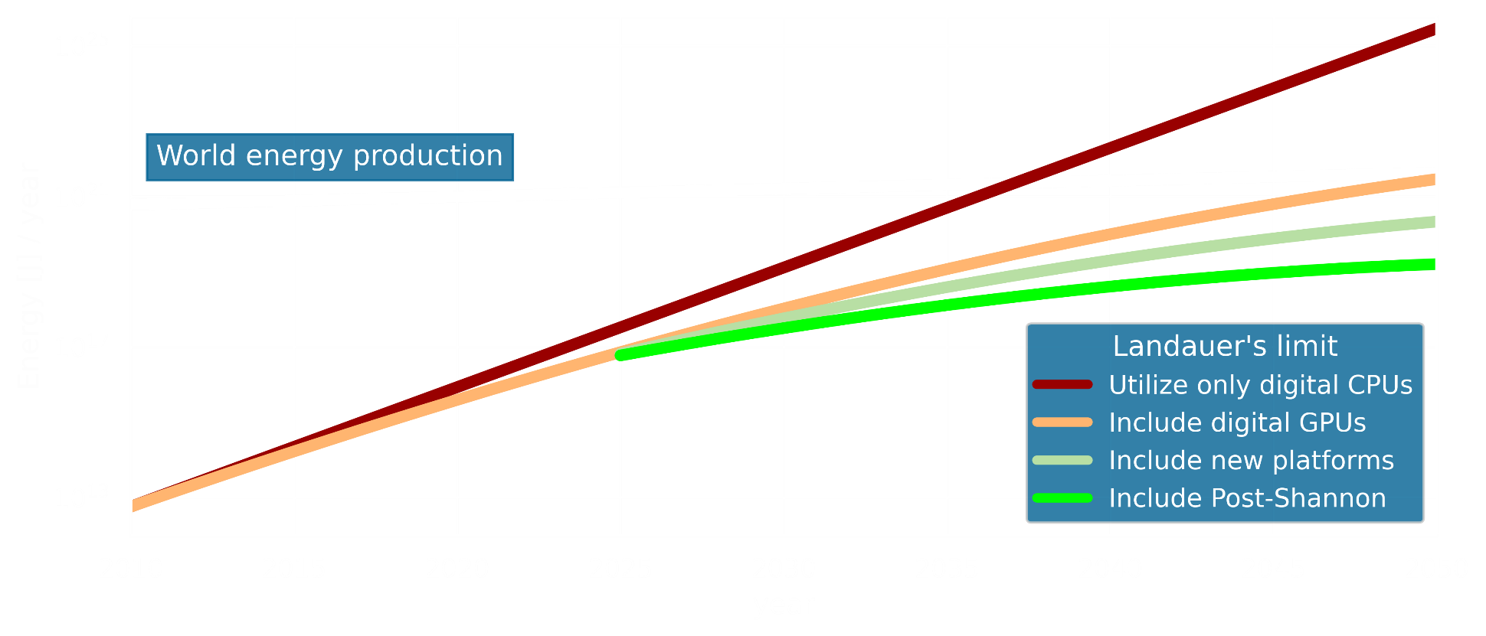
Challenges in Artificial Intelligence: Sustainability / Energy Efficiency
Novel Mathematical Method!
Source: Decadal Plan of the Semiconductor Research Corporation for the Biden (US) Administration, 2021

Slide 10
Taking a Mathematical Perspective

Slide 11
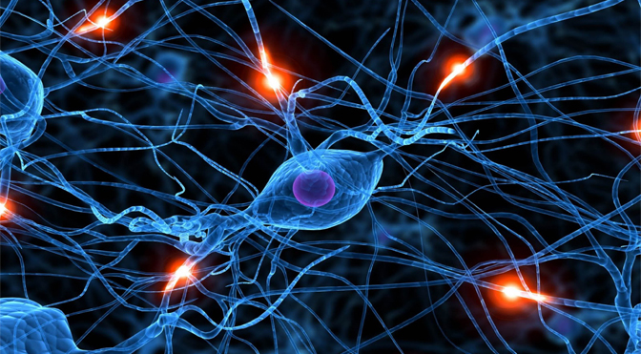
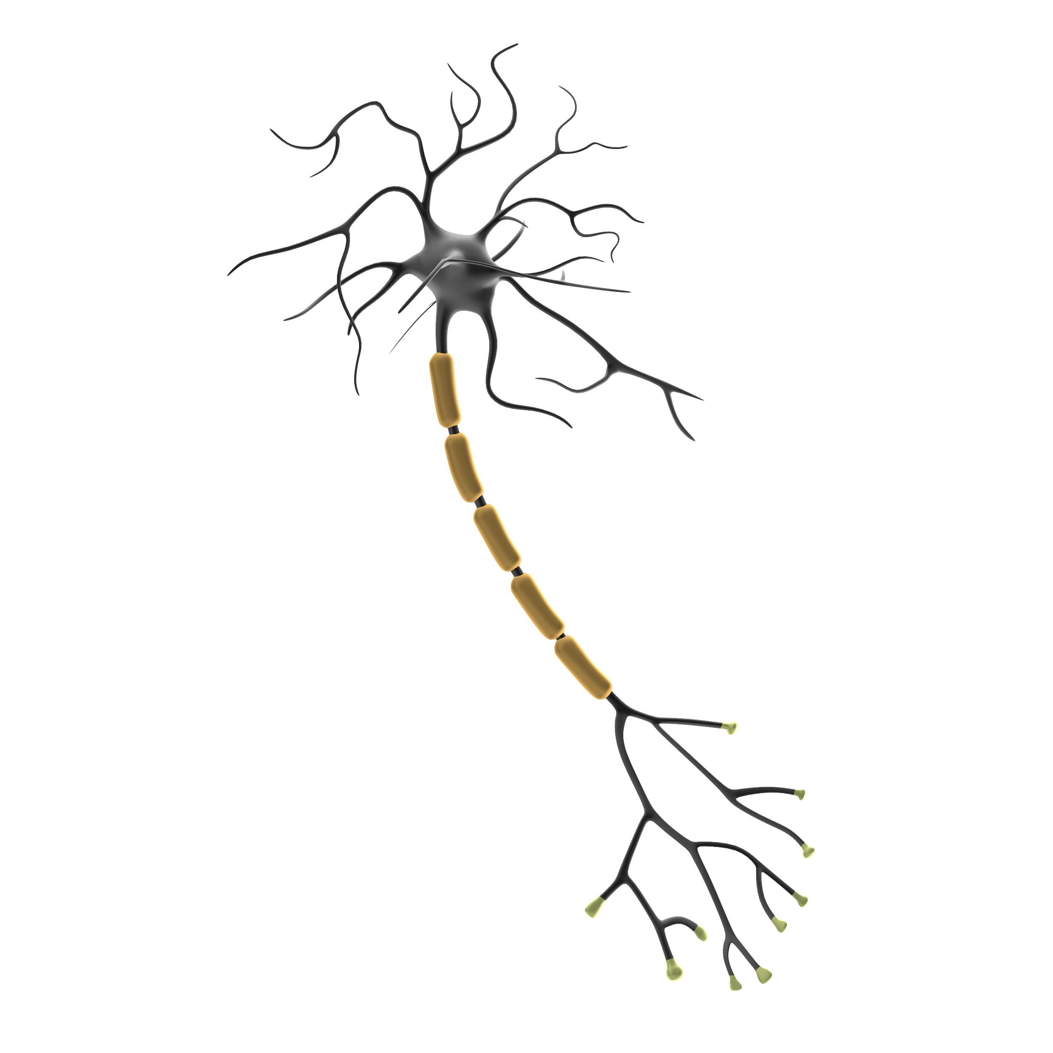
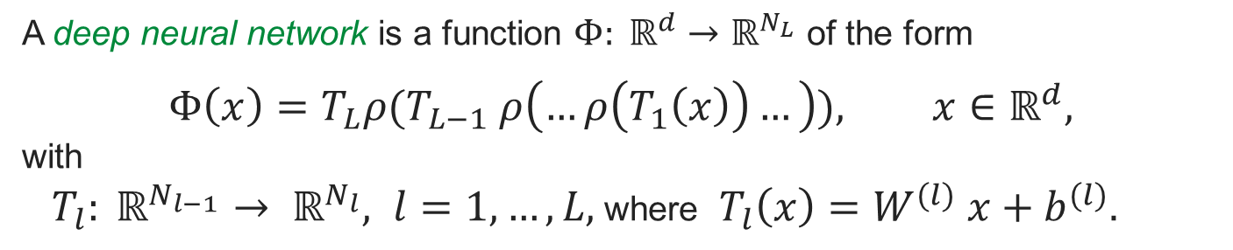

Deep Neural Networks
Key Goal of McCulloch and Pitts (1943):
Introduce artificial Intelligence!
Artificial Neurons:
$$f\left(x_{1},…,x_{n}\right)= ρ \left(\sum_{i=1}^{n}{x_{i}w_{i}−b }\right)$$
Definition of a Neural Network:
A deep neural network is a function $Φ: ℝ^{d}→ℝ^{N_{L}}$ of the form
$$Φ\left(x\right)=T_{L}ρ(T_{L−1} ρ\left(…ρ\left(T_{1}\left(x\right)\right)…\right)), x∈ℝ^{d},$$
with
$T_{l}: ℝ^{N_{l−1}}→ ℝ^{N_{l}}, l=1,…,L,$where $T_{l}\left(x\right)=W^{(l)} x+b^{(l)}.$

Slide 12
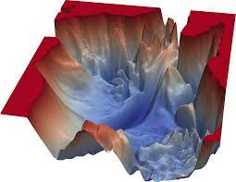






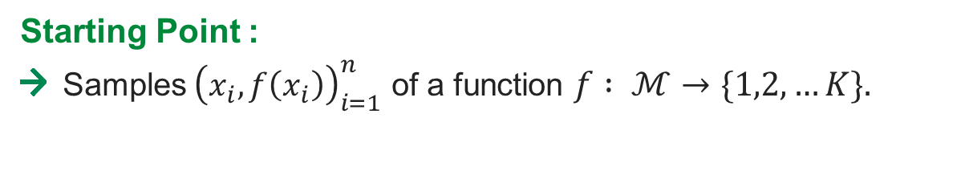
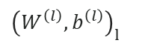

Workflow of Applying Deep Neural Networks
Starting Point :
Samples${\left(x_{i},f\left(x_{i}\right)\right)}_{i=1}^{n}$ of a function $f : ℳ→\{1,2,…K\}.$
Split into training- and test data set.
Selection of Architecture:
Choose the number of layers, the number of neurons in each layer, etc.
Training:
Learn the affine-linear functions $T_{l}\left(x\right)=W^{(l)}x+b^{(l)},l=1, …, L$via
$$min \left(\sum_{i=1}^{m}{ℒ(Φ_{{\left(W^{\left(l\right)},b^{\left(l\right)}\right)}_{l}}\left(x_{i}\right),f\left(x_{i}\right))} \right)$$
${\left(W^{\left(l\right)},b^{\left(l\right)}\right)}_{l}$
Performance Check:
For the test data set:
$$Φ_{{\left(W^{\left(l\right)},b^{\left(l\right)}\right)}_{l}}\left(x_{i}\right)≈f\left(x_{i}\right)$$

Slide 13




Towards a Mathematical Foundation for Reliable AI
Expressivity:
Which aspects of a neural network architecture affect the performance of AI-systems?
Deriving general guidelines of how to choose the network architecture!
Learning:
Why does stochastic gradient descent converge to good local minima despite the non-convexity of the problem?
Understanding how to best design the training algorithm!
Generalization:
Can we derive an understanding of the performance on the test data set?
Providing success guarantees and error bounds!
Explainability:
Why did a trained deep neural network reach a certain decision?
Ensuring trustworthiness and complying with legal regulations!

Slide 14
A Glimpse into Generalization:
Mathematical Success Guarantees

Slide 15
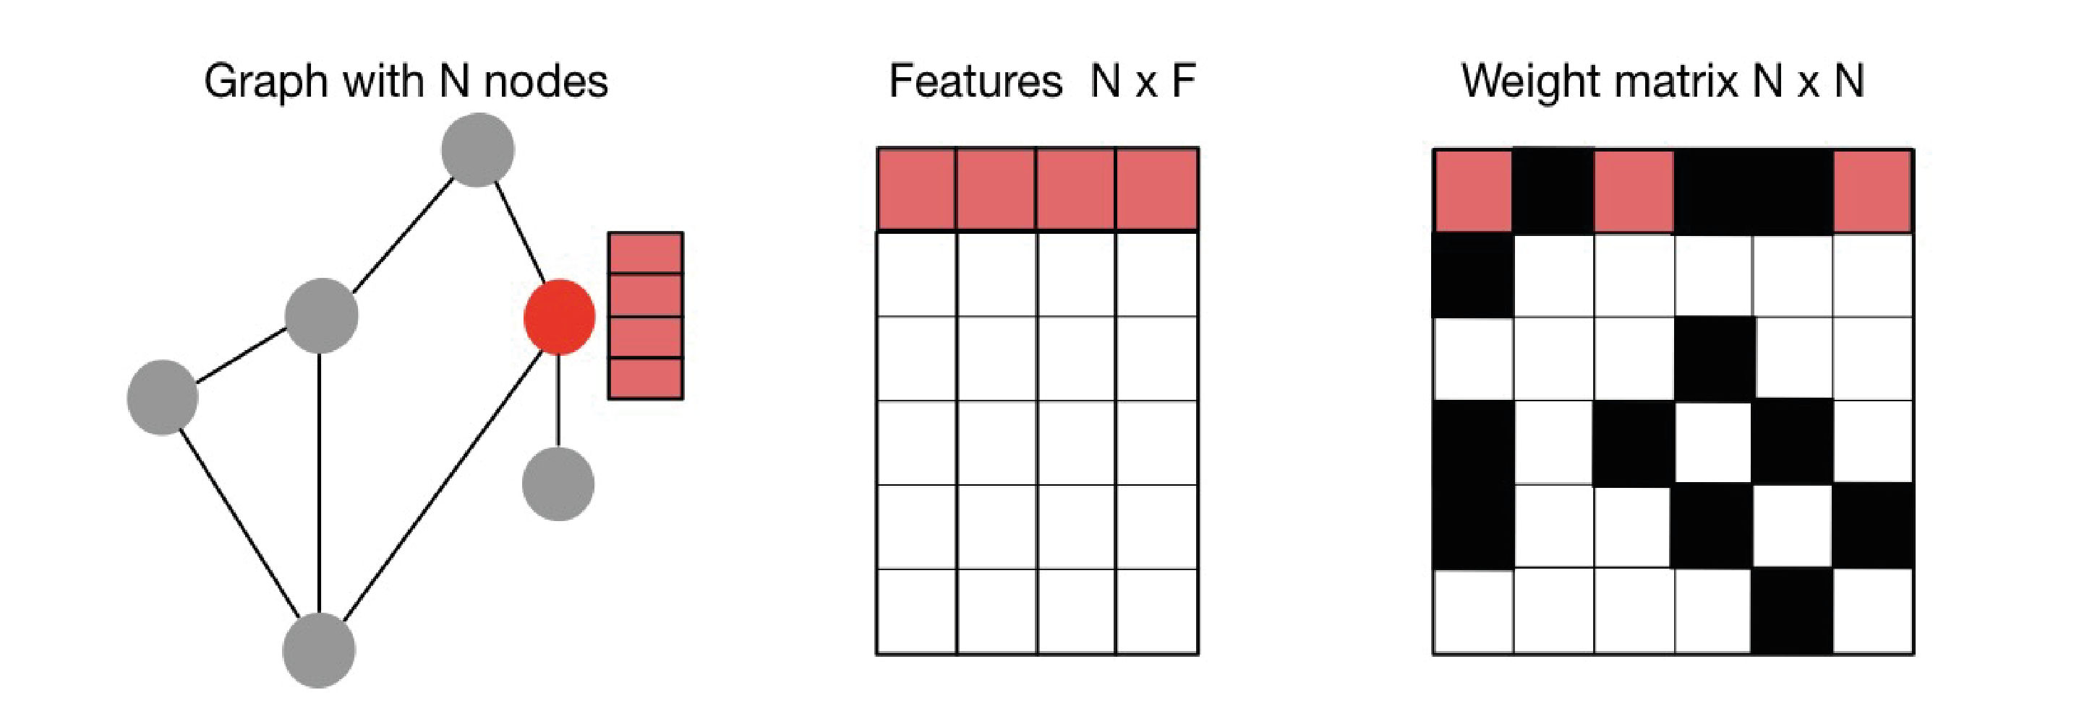
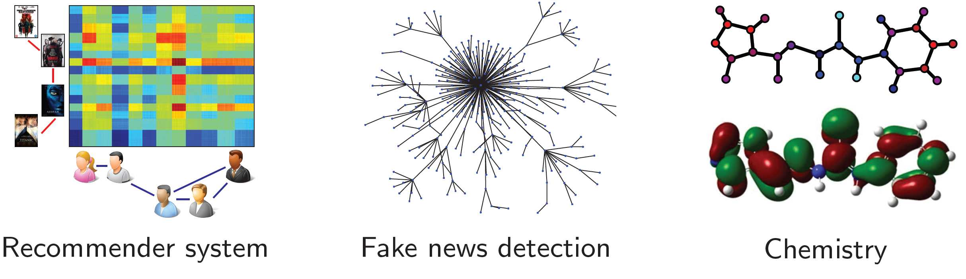
Graph Neural Networks
Graph neural networks generalize classical neural networks to signals over graph domains.
Graph signal:
Exemplary Applications:

Slide 16
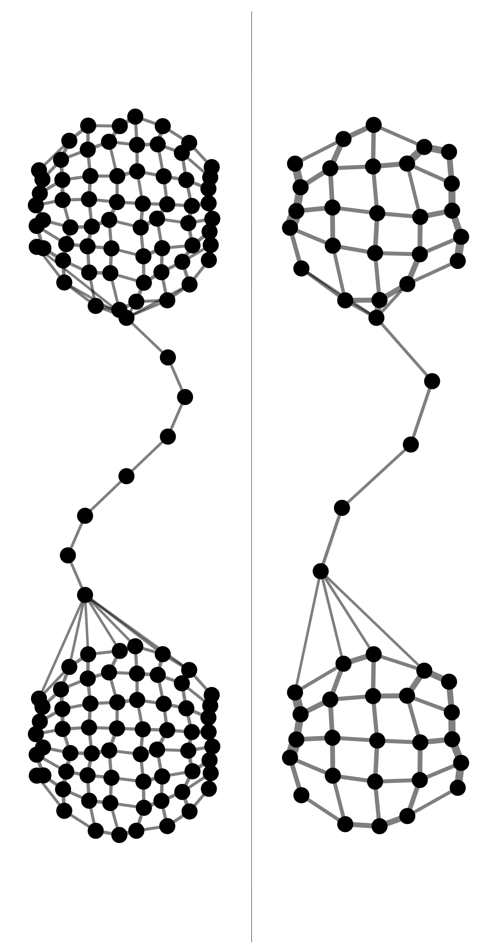
A Special Form of Generalization Capability
General Form of Generalization:
Graph neural networks should generalize to graphs and signals unseen in the training set.

Slide 17
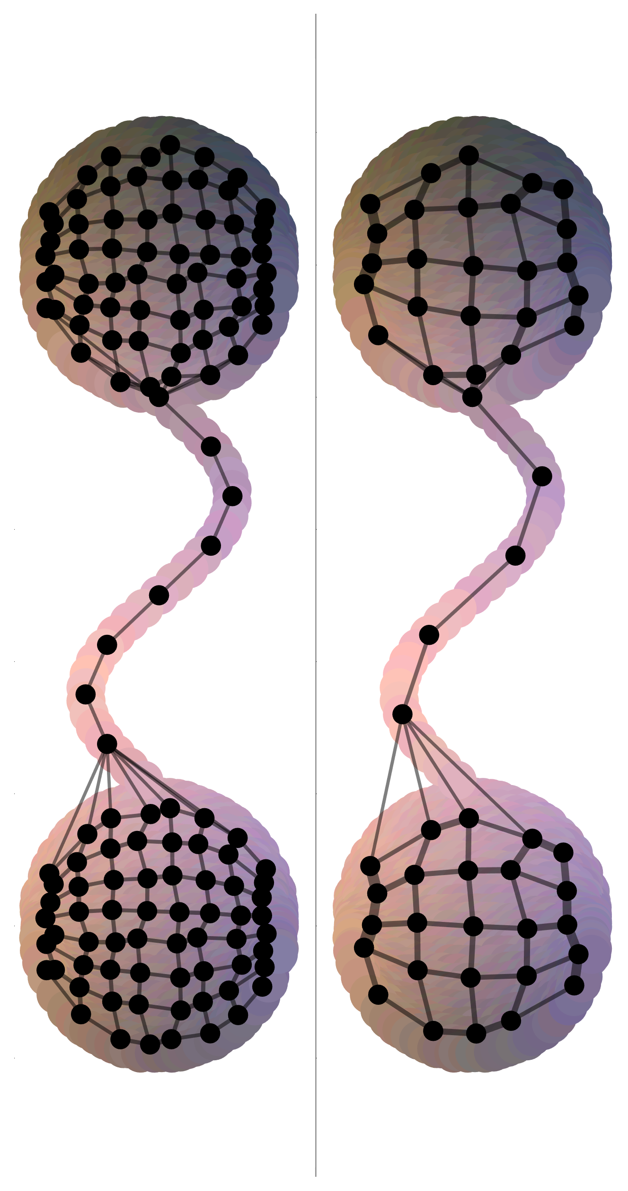
A Special Form of Generalization Capability
General Form of Generalization:
Graph neural networks should generalize to graphs and signals unseen in the training set.
The Concept of Transferability:
If two graphs model the same phenomenon, a trained graph neural network should have approximately the same repercussion on both graphs.
Some Common Approaches:
Metric (Continuum) Space Sampling
Graphon Approach

Slide 18
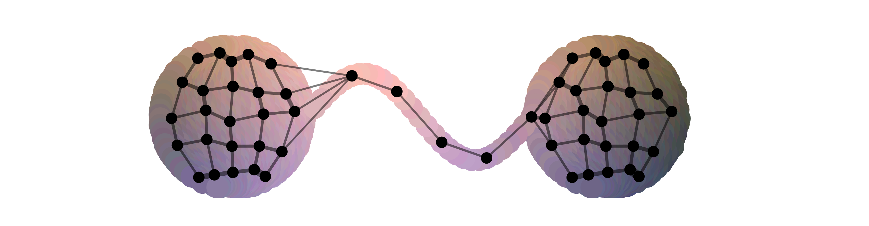
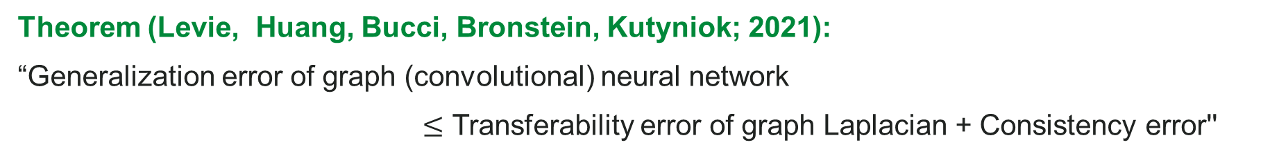
Estimate of Generalization Error
Theorem (Levie, Huang, Bucci, Bronstein, Kutyniok; 2021):
“Generalization error of graph (convolutional) neural network
$≤$ Transferability error of graph Laplacian + Consistency error''
Key Idea:
Use graph convolutional neural networks with specific spectral filters; this…
Introduce functional analytic framework akin the Nyquist—Shannon digital signal processing
Compare action of graph network on two similar graphs via metric (continuum) space
...solves the instability problem (Levie, Isufi, Kutyniok; 2019)
...solves the computational problem for a large class of filters.

Slide 19
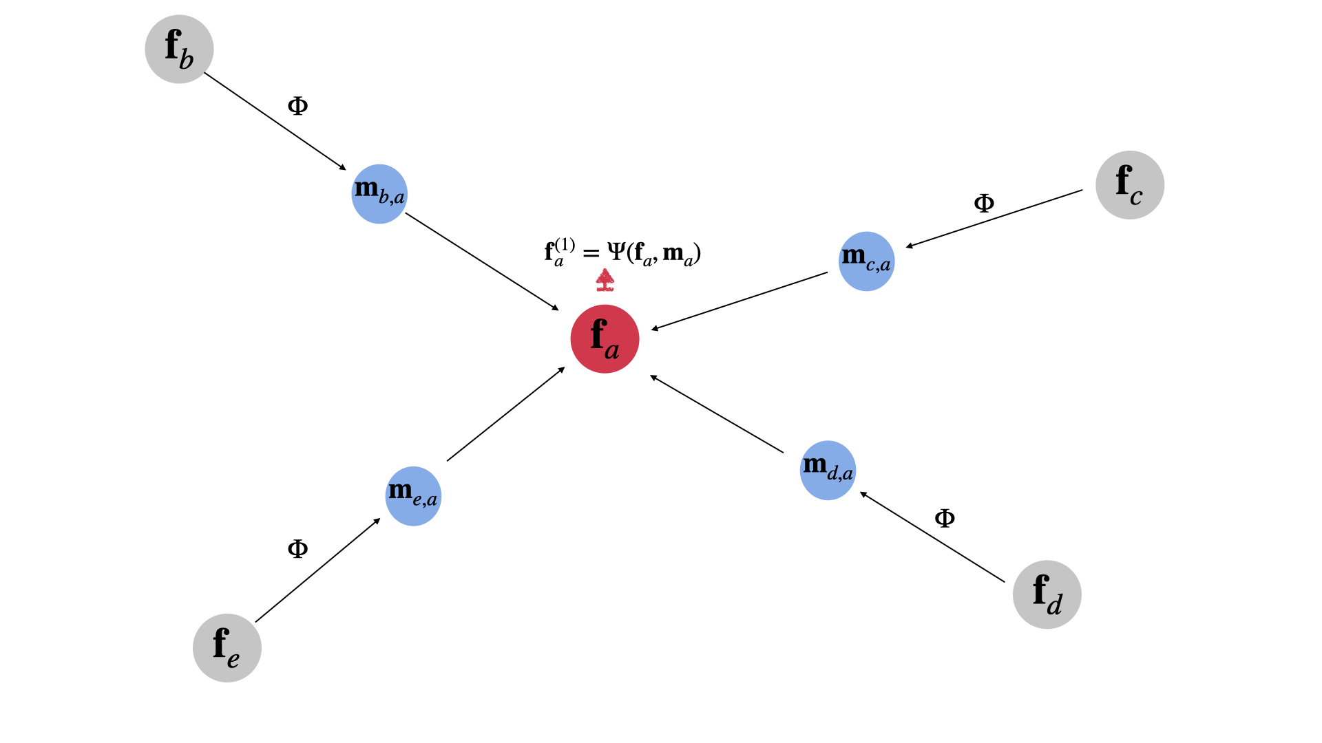
Further Results on Generalization Ability of GNNs
Graph Convolutional Neural Networks:
Similar results on transferability for the graphon setting (Maskey, Levie, Kutyniok; 2022 & 2024).
This builds on (Ruiz, Wang, Ribeiro; 2021).
Message Passing Graph Neural Networks:
Non-asymptotic generalization bounds, only depending on the regularity of the network and space (Maskey, Levie, Lee, Kutyniok; 2023).
This builds on (Garg, Jegelka, Jaakkola; 2020), (Verma, Zhang; 2019), (Yehudai, Fetaya, Meirom, Chechik, Maron; 2022).

Slide 20
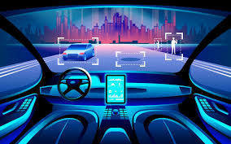
Towards a Mathematical Foundation for Reliable AI
Expressivity:
Which aspects of a neural network architecture affect the performance of AI-systems?
Deriving general guidelines of how to choose the network architecture!
Learning:
Why does stochastic gradient descent converge to good local minima despite the non-convexity of the problem?
Understanding how to best design the training algorithm!
Generalization:
Can we derive an understanding of the performance on the test data set?
Providing success guarantees and error bounds!
Explainability:
Why did a trained deep neural network reach a certain decision?
Ensuring trustworthiness and complying with legal regulations!

Slide 21
Explainability:
A Mathematical Approach

Slide 22
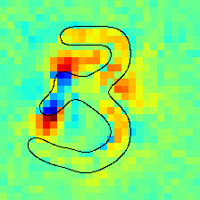
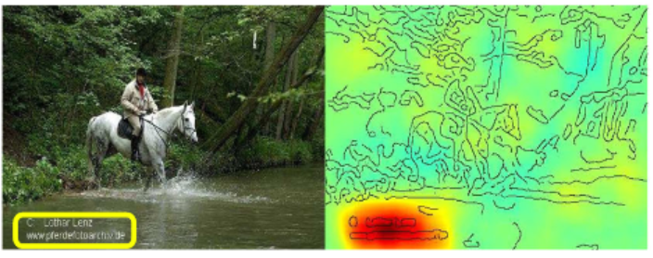


Some General Thoughts about Explainability
Main Goal: We aim to understand decisions of ``black-box'' predictors!
Source: Lapuschkin, Wäldchen, Binder, Montavon, Samek, Müller; 2019)
Selected Questions:
What exactly is relevance in a mathematical sense?
Can we develop a theory for optimal relevance maps?
Can we derive meaningful higher level explanations?
Vision:
Questioning the AI as a human about the reason for a decision!
The explainability approach itself needs to be reliable!

Slide 23

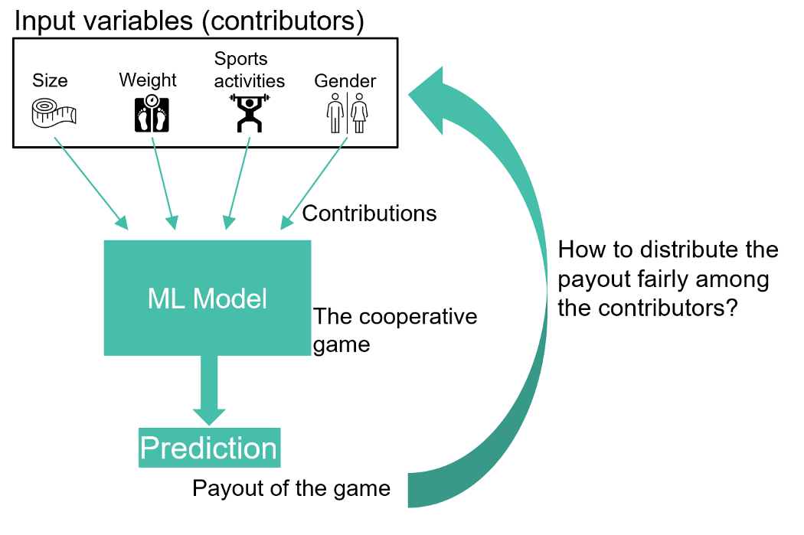
Some Categories of Explainability Methods (Model-Agnostic & Model-Specific)
Gradient based methods:
Sensitivity Analysis, SmoothGrad, etc.
Backwards propagation based methods:
Guided Backprop, Layer-wise Relevance, Deep Taylor, etc.
Surrogate model based methods:
LIME, etc.
Game theoretic methods:
Shapley values, SHAP, etc.
Neuro-symbolic methods:
NeSy XIL, etc.

Slide 24


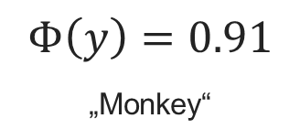

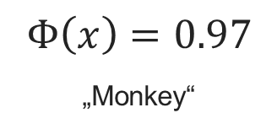

Information Theory: Rate-Distortion Viewpoint
The Setting:
Let $Φ :{\left[0,1\right]}^{d}→\left[0,1\right]$be a neural network.
Part of the Message
Alice Bob
Message
Distorted Message
$$Φ\left(x\right)=0.97$$
„Monkey“
Message
Distorted Message
$$Φ\left(y\right)=0.91$$
„Monkey“
Original image $x$ Partial image $S$ Random completion $y$
Expected Distortion:
$D\left(S\right)=D\left(Φ,x,S\right)=𝔼\left[\frac{1}{2}{\left(Φ\left(x\right)−Φ\left(y\right)\right)}^{2}\right]$
Rate-Distortion Function:
$R\left(ε\right)=$ min$\{\left|S\right| : D\left(S\right)≤ε\}$
$$S⊆\{1,…,d\}$$
Use this viewpoint for the definition of a relevance map!

Slide 25
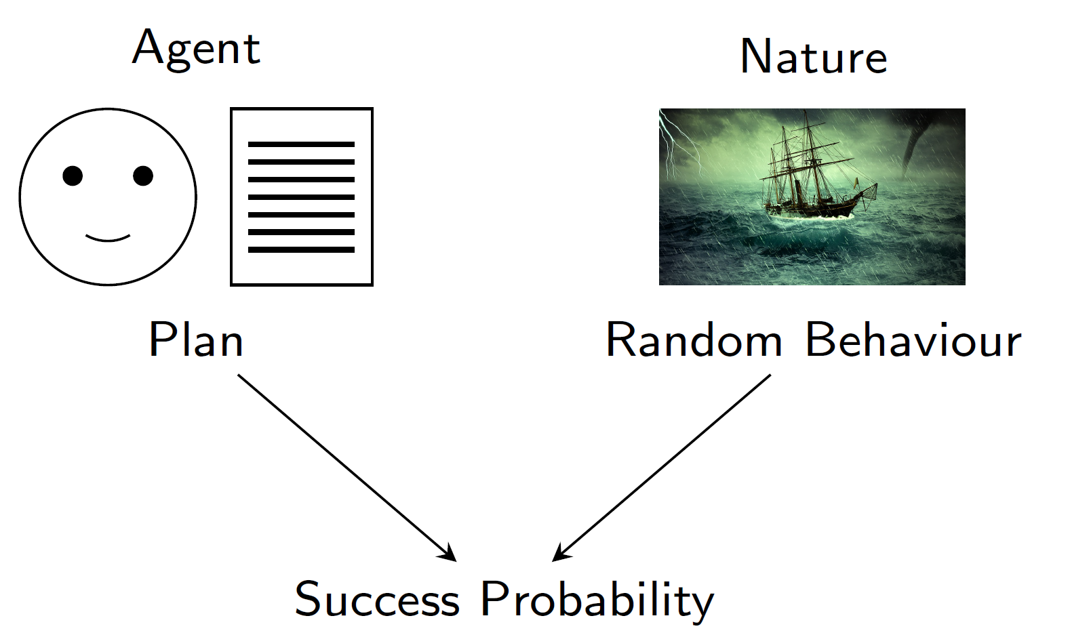
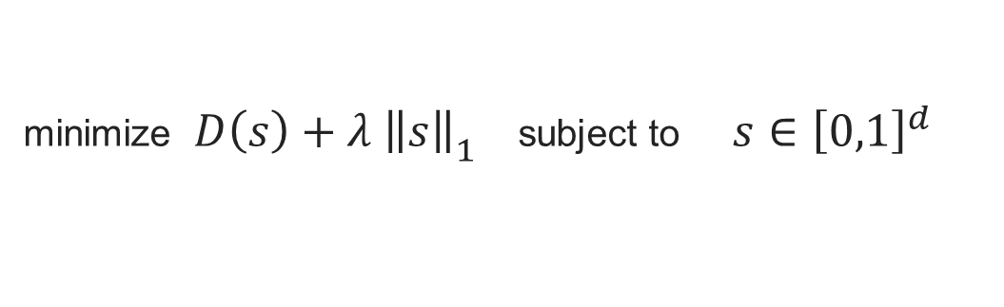
Rate-Distortion Explanation (RDE)
Theorem (Wäldchen, Macdonald, Hauch, Kutyniok; 2021):
“Solving this problem is $NP^{PP}−$complete, even computing an approximation is $NP−$hard.“
Some Examples:
Planning under uncertainties
Finding maximum a-posteriori configurations in graphical models
Maximizing utility functions in Bayesian networks
Computable Variant of RDE (Macdonald, Wäldchen, Hauch, Kutyniok, 2020):
minimize $D\left(s\right)+λ {\left\|\left.s\right\|\right.}_{1}$ subject to $s∈{\left[0,1\right]}^{d}$
…allows rigorous mathematical performance analysis!

Slide 26
STL-10 Experiment

Slide 27
STL-10 Experiment

Slide 28

Going Beyond….
Extending to More Realistic Scenarios?
Extension 1 (Heiß, Levie, Resnick, Kutyniok, Bruna; 2020):
Choose the obfuscations more natural
Example: Apply an inpainting GAN
Obtaining Higher-Level Explanations?
Extension 2 (Kolek, Nguyen, Levie, Bruna, Kutyniok; 2021):
Apply RDE to decompositions of the data
Example: Take a wavelet decomposition of an image.
CartoonX

Slide 29
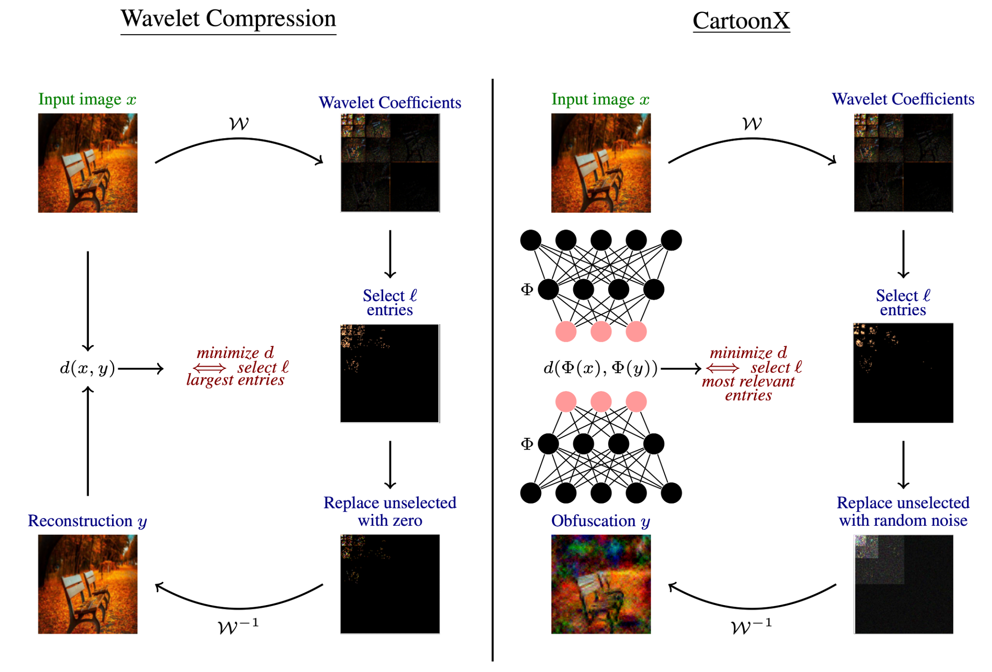
Idea of CartoonX (Kolek, Nguyen, Levie, Bruna, Kutyniok; 2022)

Slide 30
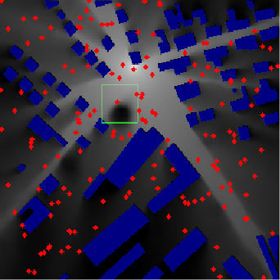
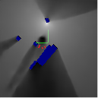
Explainability: Understanding Seemingly Wrong Decisions
Example from Telecommunication:
Estimated RadioMap via RadioUNet
(Levie, Cagkan, Kutyniok, Caire; 2020)
Rate-Distortion Explanation
(Heiß, Levie, Resnick, Kutyniok, Bruna; 2020):

Slide 31
Explainability: Understanding Wrong Decisions
Example from Imaging:
Wrong decision by AI:
Diaper
Wrong decision by AI:
Screw

Slide 32
Explainability: Understanding Wrong Decisions
Example from Imaging:
Explanation by CartoonX
(Kolek, Nguyen, Levie, Bruna, Kutyniok; 2021)
Explanation by CartoonX
Extension: ShearletX (Kolek, Windesheim, Loarca, Kutyniok, Levie; 2023)!

Slide 33
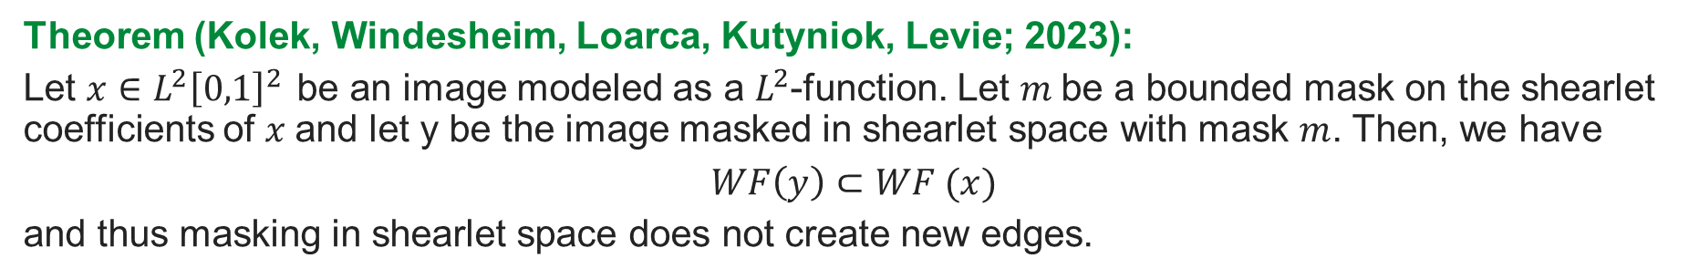
Mathematical Underpinning: Ensuring Reliability
Problem:
Theorem (Kolek, Windesheim, Loarca, Kutyniok, Levie; 2023):
Let $x∈L^{2}{\left[0,1\right]}^{2 }$be an image modeled as a $L^{2}$-function. Let $m$be a bounded mask on the shearlet coefficients of $x$and let y be the image masked in shearlet space with mask $m$. Then, we have
$$WF\left(y\right)⊂WF (x)$$
and thus masking in shearlet space does not create new edges.

Slide 34
Towards a Mathematical Foundation for Reliable AI
Expressivity:
Which aspects of a neural network architecture affect the performance of AI-systems?
Deriving general guidelines of how to choose the network architecture!
Learning:
Why does stochastic gradient descent converge to good local minima despite the non-convexity of the problem?
Understanding how to best design the training algorithm!
Generalization:
Can we derive an understanding of the performance on the test data set?
Providing success guarantees and error bounds!
Explainability:
Why did a trained deep neural network reach a certain decision?
Ensuring trustworthiness and complying with legal regulations!

Slide 35
A Glimpse into Problems of
Compliance with the EU AI Act

Slide 36


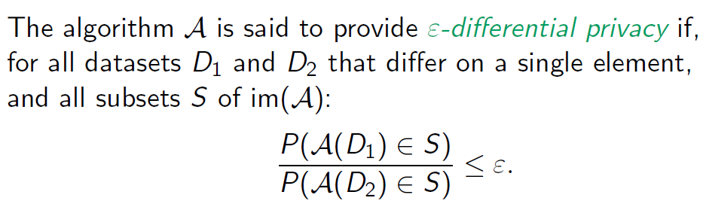
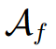
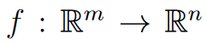
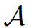
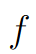

Challenges in Artificial Intelligence: EU AI Act
Exemplary Requirements from the EU AI Act:
Article 43: Conformity Assessment
Article 50: Transparency Obligations for Providers and Deployers
Article 86: Right to Explanation of Individual Decision-Making
!
Differential Privacy (Formalization of “Privacy”):
Current Danger:
Enormous costs for small-size companies and start-ups.
Uncertainty and potential disadvantage in Europe
Algorithmic Transparency (Boche, Fono, Kutyniok; 2024):
An algorithmic implementation is transparent in a given computing model if the realization of some function
by an algorithm is not altered by its implementation in the computing model. We then say that allows for a transparent algorithmic implementation in the given computing model.
A „Formalization“ of the legal requirements of the EU AI Act would allow a fair, low-cost, and automatic verification!

Slide 37





Research Project of the Bavarian AI Act Accelerator
Exemplary Requirements from the EU AI Act:
Article 43: Conformity Assessment
Article 50: Transparency Obligations for Providers and Deployers
Article 86: Right to Explanation of Individual Decision-Making
!
Differential Privacy (Formalization of “Privacy”):
Current Danger:
Enormous costs for small-size companies and start-ups
Uncertainty and potential disadvantage in Europe
Algorithmic Transparency (Boche, Fono, Kutyniok; 2024):
An algorithmic implementation is transparent in a given computing model if the realization of some function
by an algorithm is not altered by its implementation in the computing model. We then say that allows for a transparent algorithmic implementation in the given computing model.
A „Formalization“ of the legal requirements of the EU AI Act would allow a fair, low-cost, and automatic verification!

Slide 38
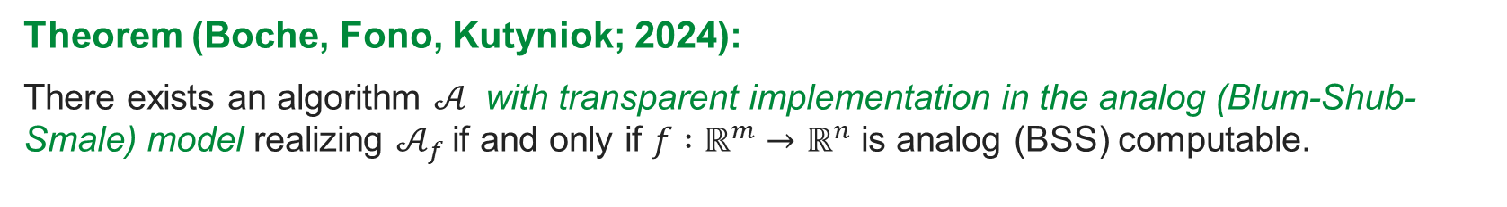
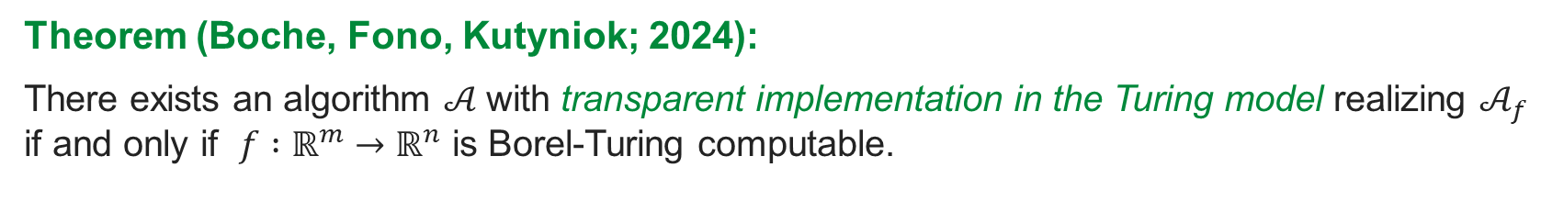
EU AI Act: The Role of the Computing Platform
Theorem (Boche, Fono, Kutyniok; 2024):
There exists an algorithm $𝒜$with transparent implementation in the Turing model realizing $𝒜_{f}$ if and only if $f :ℝ^{m}→ℝ^{n}$ is Borel-Turing computable.
Theorem (Boche, Fono, Kutyniok; 2024):
There exists an algorithm $𝒜$ with transparent implementation in the analog (Blum-Shub-Smale) model realizing $𝒜_{f}$if and only if $f :ℝ^{m}→ℝ^{n}$ is analog (BSS) computable.
Digital hardware can also cause problems of compliance with the EU AI Act!

Slide 39
Towards a Mathematical Foundation for Reliable AI
Expressivity:
Which aspects of a neural network architecture affect the performance of AI-systems?
Deriving general guidelines of how to choose the network architecture!
Learning:
Why does stochastic gradient descent converge to good local minima despite the non-convexity of the problem?
Understanding how to best design the training algorithm!
Generalization:
Can we derive an understanding of the performance on the test data set?
Providing success guarantees and error bounds!
Explainability:
Why did a trained deep neural network reach a certain decision?
Ensuring trustworthiness and complying with legal regulations !
!
…toward the core of the reliability and sustainability problem!

Slide 40




Computing in the 21th Century
Importance of Computing:
Digital Transformation
(Generative) AI
Virtual Reality
Information and Communication Technology (ICT)
Ubiquitous Computing
Large-Scale Computing
Fast Computing
Distributed Computing
Computing is the heart of modern technology, powering innovation, transforming industries, and shaping the future of our society!

Slide 41
Reliable and Sustainable AI:
The Need to Rethink Current Computing!

Slide 42


Are There Fundamental Limitations to Be Aware Of?
…Delving Deeper!
What can actually be computed on digital hardware?
Turing-Machine
A computable problem (function) is one for which the input-output relation can be computed on a digital machine for any given accuracy.
What about Non-Computability?
Non-computable problems can be tackled successfully in practice, if limited precision succeeds!
But we have no guarantees of correctness, hence no reliability!

Slide 43

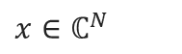
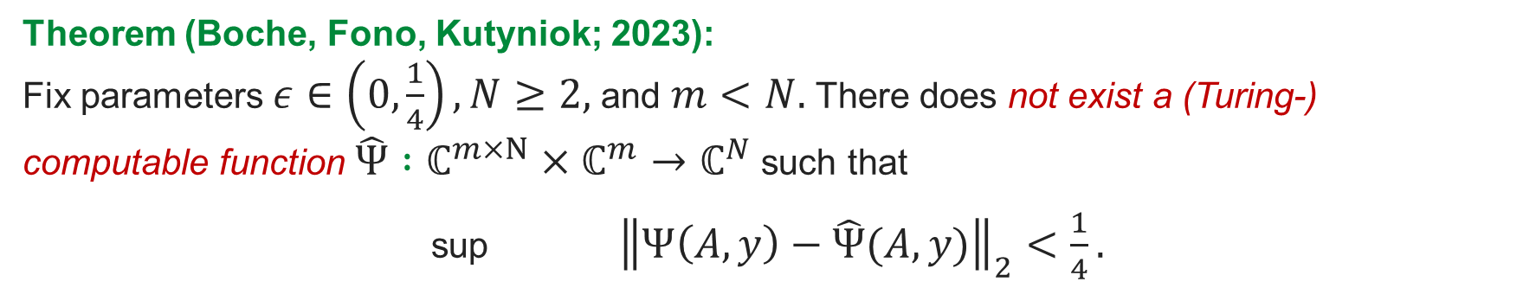

Very Disappointing News
Theorem (Boche, Fono, Kutyniok; 2023):
The solution of a finite-dimensional inverse problem is not (Turing-)computable (by a deep neural network).
Solution Set: For $A∈ℂ^{m×N}$ and $y∈ℂ^{m}$let
$Ψ\left(A,y\right)≔$arg min ${\left\|x\right\|}_{1}$such that ${\left\|Ax−y\right\|}_{2}≤ε.$
$x∈$ $ℂ^{N}$
Theorem (Boche, Fono, Kutyniok; 2023):
Fix parameters $ε∈\left(0,\frac{1}{4}\right), N≥2,$and $m<N.$There does not exist a (Turing-) computable function $\hat{Ψ} :ℂ^{m×N}×ℂ^{m}→ℂ^{N}$such that
sup ${\left\|Ψ\left(A,y\right)−\hat{Ψ}(A,y)\right\|}_{2}<\frac{1}{4}.$
$$\left(A,y\right)∈ℂ^{m×N}×ℂ^{m}$$

Slide 44
More Problems with Digital Hardware
Theorem (Boche, Fono, Kutyniok; 2023): Many classification problems are also not (Turing) computable!
Theorem (Boche, Fono, Kutyniok; 2023): The Pseudo Inverse is not (Banach-Mazur) computable!
Theorem (Bacho, Boche, Kutyniok; 2024): Computing the solutions to the Laplace and the diffusion equation on digital hardware causes a complexity blowup.
Theorem (Lee, Boche, Kutyniok; 2024): Finding the solution of most optimization problems is not (Turing-)computable; it can not even be approximated by a Turing computable function!

Slide 45

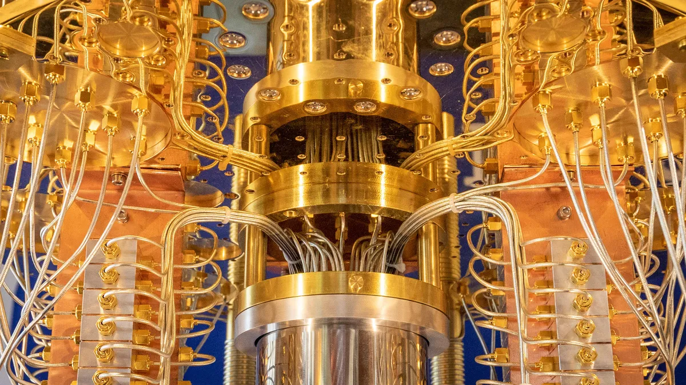
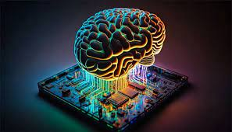
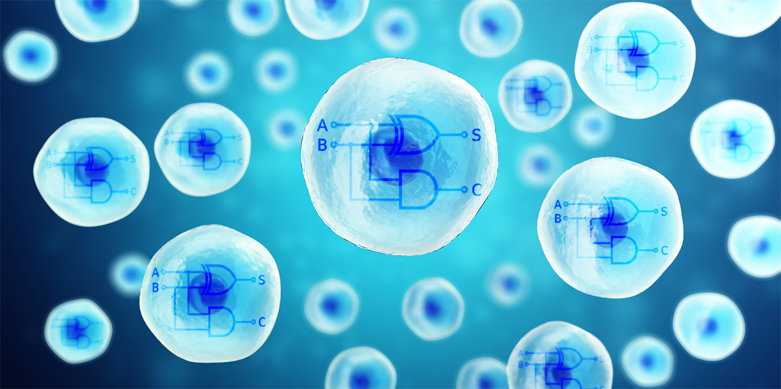


What now?
Theory tells us…
Theorem (Boche, Fono, Kutyniok; 2024):
The solution of a finite-dimensional inverse problem is computable (by a deep neural network) on an analog (Blum-Shub-Smale) machine!
Reliability for certain problem settings requires novel hardware!
Exciting Future Developments:
Neuromorphic computing
Biocomputing
Quantum computing
Highly energy efficient!
https://www.ecologic-computing.com
Reliable and Sustainable AI...by Next Generation AI Computing!

Slide 46
Next Generation AI Computing

Slide 47
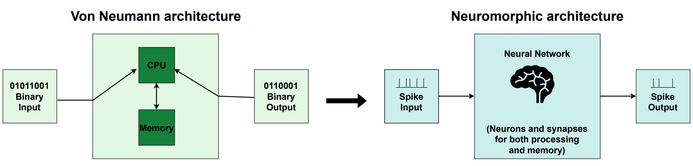
Neuromorphic Hardware
Features of Neuromorphic Hardware:
Closer to the human brain.
Energy efficiency.
Execution speed.
Robustness.
….
What is the correct type of neural network?

Slide 48
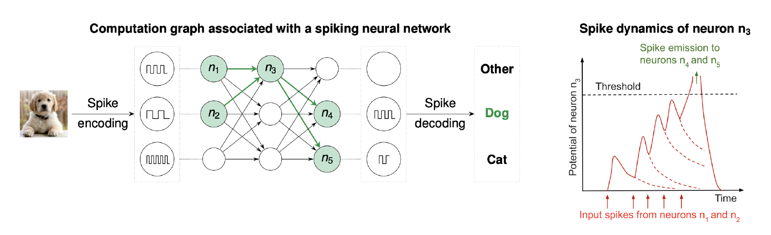
The Framework of Spiking Neural Networks
Remarks:
More biologically realistic than first and second generation artificial neurons.
Information is encoded in the timing of individual spikes.
Numerous models for spiking neurons exist; one of those is the Spike Response Model.
Time is one crucial factor in this model!

Slide 49


Our Focus: Expressivity
How expressive are spiking neural networks compared to classical networks?
Function approximation:
How well do the realizations of a neural
network approximate a target function?
Number of linear regions:
How does the network partition the input space, affecting decision boundaries?
Generalization: Neuman, Dold, Petersen; 2024

Slide 50



The Spike Response Model (SRM)
Definition: A SRM (spiking neural) network $Φ$is a directed graph $\left(V,E\right)$ and consists of a finite set $V$of spiking neurons, a subset $V_{in}⊂V$of input neurons, and a set $E⊂V×V$of synapses. Each synapse $\left(u,v\right)∈E$ is associated with
a synaptic weight $w_{uv}≥0,$
a synaptic delay $d_{uv}≥0,$
and a response function $ε_{uv} : ℝ→ℝ$.
Each neuron $v∈V ∖ V_{in}$is associated with
a firing threshold $θ_{v}> 0,$
and a membrane potential $P_{v} : ℝ→ℝ,$
which is given by
$$P_{v}\left(t\right)= \sum_{\left(u,v\right)∈E}{\sum_{t_{u}^{f}∈F_{u}}{w_{uv}ε_{uv}(t−t_{u}^{f})}}$$
with $F_{u}=\{t_{u}^{f}:1≤f≤n$for some $n∈ℕ\}$being the set of firing times of neuron $u$, i.e., times $t$ whenever $P_{u}\left(t\right)$reaches $θ_{u}$.

Slide 51


Spike Response Model Networks: Function Approximation
Theorem (Singh, Fono, Kutyniok; 2024):
Let $L,d∈ℕ$, ${\left[a,b\right]}^{d}⊆ℝ$, and let $Ψ$be a classical ReLU-neural network of depth $L$and width $d$. Then there exists a SRM network $Φ$with $N\left(Φ\right)=N\left(Ψ\right)+L\left(2d+3\right)−\left(2d+2\right)$and $L\left(Φ\right)=3L−2$that realizes the output of $Ψ$ on ${\left[a,b\right]}^{d}$.
Theorem (Singh, Fono, Kutyniok; 2024):
For $d≥2, ℓ≔\left[\log_{2}\left(d+1\right)\right]+1.$ For $Φ$ being a 1-layer SRM network with one output neuron $v$and $d$input neurons $u_{1},…u_{d}$with $w_{u_{i}v}∈ℝ_{>0}$ for $i∈\{1,…,d\}$. Then
$t_{Φ}$can be realized by a classical ReLU-neural network $Ψ$with $L\left(Ψ\right)=ℓ$and $N\left(Φ\right)∈O\left(t⋅2^{2d^{3}+3d^{2}+d}\right)$.
$t_{Φ}$can be realized by a classical ReLU-neural network $Ψ$with $L\left(Ψ\right)∈O(d)$and $N\left(Φ\right)∈O\left(8^{d}\right)$.

Slide 52


SRM Networks: Approximation of the Minimum Function
Theorem (Singh, Fono, Kutyniok; 2024):
For $d≥2$, there exists a single layer SRM network $Φ$, with linear response function, with one output neuron $v$ and $d$ input neurons, such that
$$\left|Φ\left(x_{1},…,x_{d}\right)−min⁡\{x_{1},…,x_{d}\}\right|≤\frac{\left(d−1\right)θ}{2dw},$$
where $θ>0$ is the threshold of $v$ and $w>0$ is the weight of each connection.
for all $x_{1},…,x_{d}∈ℝ,$
Comparison with ReLU-neural networks:
For any classical ReLU-neural network, irrespective of depth, to approximate min, each hidden layer must have at least 𝑑 neurons.
Under certain assumption on the weights and data distribution, a classical ReLU-neural network of depth 3 is necessary to efficiently approximate min.
Spiking neural networks are strictly more expressive!

Slide 53


SRM Networks: Linear Regions
Theorem (Singh, Fono, Kutyniok; 2024):
Let $Φ$be a one-layer SRM network with linear response, with input dimension $d$ and a single output neuron. Then the maximum number of linear regions $|ℜ|$ satisfies the tight upper bound
$$\left|ℜ\right|≤2^{d}−1$$
Some Remarks:
In comparison, one ReLU neuron divides the space only into two regions, regardless of $d.$
A single spiking neuron divides the input space with the same number of linear regions as a classical two-layer neural network with $d$ hidden neurons.
Spiking neural networks are strictly more expressive!

Slide 54



The Discrete Leaky-Integrate-and-Fire (LIF) Model
Definition: A discrete LIF (spiking neural) network $Φ$is a directed graph $\left(V,E\right)$ and consists of a finite set $V$of spiking neurons, a subset $V_{in}⊂V$of input neurons, and a set $E⊂V×V$of synapses. Each synapse $\left(u,v\right)∈E$ is associated with
a synaptic weight $w_{uv}≥0,$
Each neuron $v∈V ∖ V_{in}$is associated with
a firing threshold $θ_{v}> 0,$ a leaky parameter $β∈\left[0,1\right]$,
a latency $T∈ℕ$, a spike sequence $S_{v}∈{\left\{0,1\right\}}^{T}$,
an initial membrane potential $P_{v}\left(0\right)∈ℝ,$
and a membrane potential function $P_{v} : \{1,…,T\}→ℝ,$
which is given by
$$\left\{\begin{aligned}P_{v}\left(t\right)=βP_{v}\left(t−1\right)+\sum_{\left(u,v\right)∈E}{w_{uv}S_{u}(t)}−θ_{v}S_{v}(t) \\ S_{v}\left(t\right)=H\left(βP_{v}\left(t−1\right)+\sum_{\left(u,v\right)∈E}{w_{uv}S_{u}(t)}−θ_{v}\right),\end{aligned}\right.$$
where $H$is the Heaviside function.

Slide 55

Discrete LIF Networks: Function Approximation
Theorem (Nguyen, Araya, Fono, Kutyniok; 2025):
For any $f$ continuous with compact support in $ℝ^{d}$ and $ε>0$, there exists a discrete LIF network $Φ$ with depth $L=2,$latency $T=1$ and $O(\frac{d}{ε^{d}})$ neurons such that
${||Φ−f||}_{∞}<ε$.
Conversely, there exist continuous functions for which$O(\frac{d}{ε^{d}})$ neurons are necessary to achieve $ε$-accuracy.
Some Remarks:
This result provides optimal approximation rates in terns of the width.
It can be extended to approximate piecewise continuous functions.
Future work: Extension to the dynamic setting, i.e., when input/ouput are time series

Slide 56


Discrete LIF Networks: Linear Regions
Theorem (Nguyen, Araya, Fono, Kutyniok; 2025):
Let $Φ$be a discrete LIF network with latency $T$, width input dimension $d$ and $n_{1}$neurons on the first layer, then the maximum number of linear regions, denoted by $\left|ℜ\right|,$satisfies the tight upper bound
$\left|ℜ\right|≤\left\{\begin{aligned}\sum_{i=0}^{d}{{\left(\frac{T^{2}+T}{2}\right)}^{i}\left({n_{1} \atop i}\right) \text{for} n_{1}≥d} \\ {\left(\frac{T^{2}+T+2}{2}\right)}^{n_{1}}otherwise\end{aligned}\right.$
Some Remarks:
This result provides optimal approximation rates in terms of the width.
For $n_{1}≥d$ our result gives $O\left({T^{2d}n}_{1}^{d}\right)$ versus $O\left(n_{1}^{d}\right)$ in the case of shallow classical ReLU-neural networks.
For $n_{1}<d$ our result gives $O\left(T^{2n_{1}}\right)$ versus $O\left(2^{n_{1}}\right)$ in the case of shallow classical ReLU-neural networks.

Slide 57






Discrete LIF Networks: Linear Regions and the Role of Depth
Observations:
$|ℜ|$ does not scale with depth.
In deeper networks regions tend to ‘merge’ together.
In experiments, training have a similar ‘merging’ effect.
Experimental results

Slide 58





Discrete LIF Networks: Linear Regions and the Role of T
Observations:
Increasing 𝑇, new regions are created with parallel hyperplanes to those when 𝑇=1.
$|ℜ|$ increases polynomially in $T$ in discrete LIF networks.
In comparison, $|ℜ|$ increases exponentially in the depth $L$ in classical ReLU-neural networks.
The depth still plays a role in discrete LIF networks: merging regions when $L≥2$

Slide 59

Spiking Neuron Dynamics
Family of Models:
Spike Response Model
Leaky-Integrate-and-Fire (LIF) Model
Biophysical Models
…
Some Results for the LIF-Model (Nguyen, Araya, Fono, Kutyniok; 2025):
Optimal approximation rates for function approximation in terms of width.
Optimal approximation rates for maximal number of regions.
Some Next Steps:
Analysis of energy consumption of classical neural networks versus spiking networks.
Study of optimality of different models adapted to neuromorphic chips.

Slide 60















Vision of our Project
Comprehensive theory-driven framework
for next generation (Green) AI-systems:
Optimally application-adapted hard-software combinations for maximal energy-efficiency and reliability!
G. Kutyniok H. Boche
S. Speidel F. Fitzek
Next generation
robotics with reliable robot brains
and life-long learning capabilities!
Provably reliable
AI-based communication systems
which comply with the EU AI Act!
Low cost, trust-
worthy medical AI-devices
for diagnosis and therapy!
Bavaria
Saxony

Slide 61










Team at our Chair for
Dr. Ernesto Araya Dr. Massimiliano Datres Adalbert Fono Vit Fojtek Dr. Jianfei Li
Duc Anh Nguyen Sarah Pardo Manjot Singh Dr. Juan Suarez Cardona Jonas von Berg

Slide 62
Conclusions

Slide 63


Conclusions
Current Problems with Reliability and Sustainability of AI!
Taking a Mathematical Perspective:
Analysis of Expressivity, Training, Generalization
Explainability: Rate-Distortion Explanation / CartoonX
Fundamental Problem with Digital Hardware!
Next Generation AI Computing:
Analog hardware such as neuromorphic computing!
Analog AI systems such as spiking neural networks!
Vision: Mathematically Reliable and Sustainable AI!

Slide 64







Konrad Zuse School of Excellence in Reliable AI
(https://zuseschoolrelai.de)
Munich, Germany
Mission: Train future generations of AI experts in Germany who combine technical brilliance with awareness of the importance of AI’s reliability

Slide 65


Thank you very much
for your attention!
References available at:
www.ai.math.lmu.de/kutyniok
Survey Papers:
Berner, Grohs, Kutyniok, Petersen, The Modern Mathematics of Deep Learning, 2021
Fono, Singh, Araya, Petersen, Boche, Kutyniok, Sustainable AI: Mathematical Foundations of Spiking Neural Networks, 2025
Related Book:
Grohs and Kutyniok, eds., Mathematical Aspects of Deep Learning, Cambridge University Press, 2022.

